Slide 1

Intro to Machine Learning on the cheap and without a PhD in math: Overview
About this session
Brief History of Machine Learning
What’s the Plan (Who and How)?
Things You Can Do After 7 Lessons
4 Quick Examples
Links and Additional Resources
Q/A

Slide 2
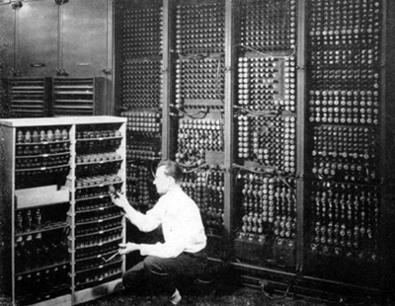
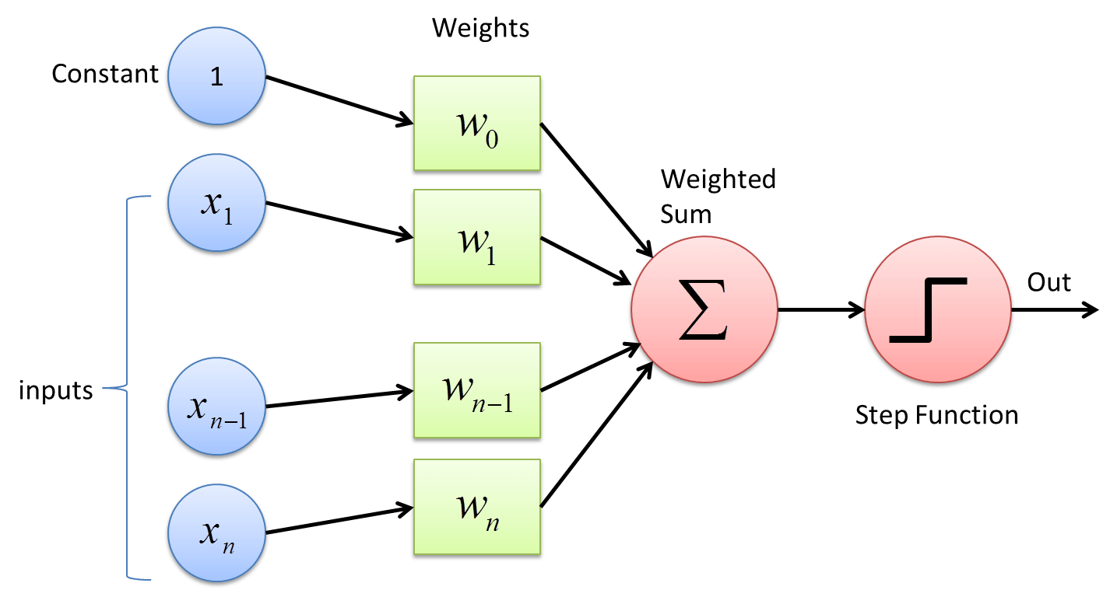
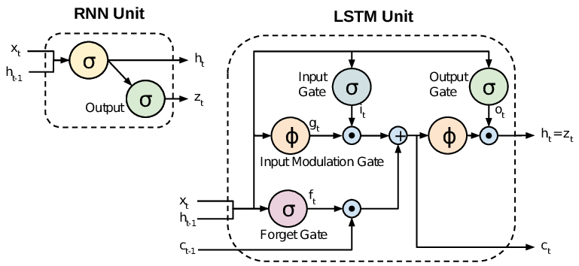
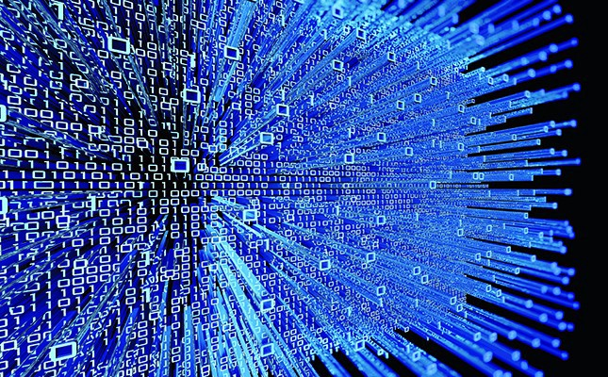
Brief History of Machine Learning
First ML ideas date back to 1950s (Rosenblatt:Perceptron)
Limited by computing power
Esoteric techniques and technology requiring a PhD
Traditionally required immense data
TODAY: PhD, GPUs, and immense data are NOT required

Slide 3
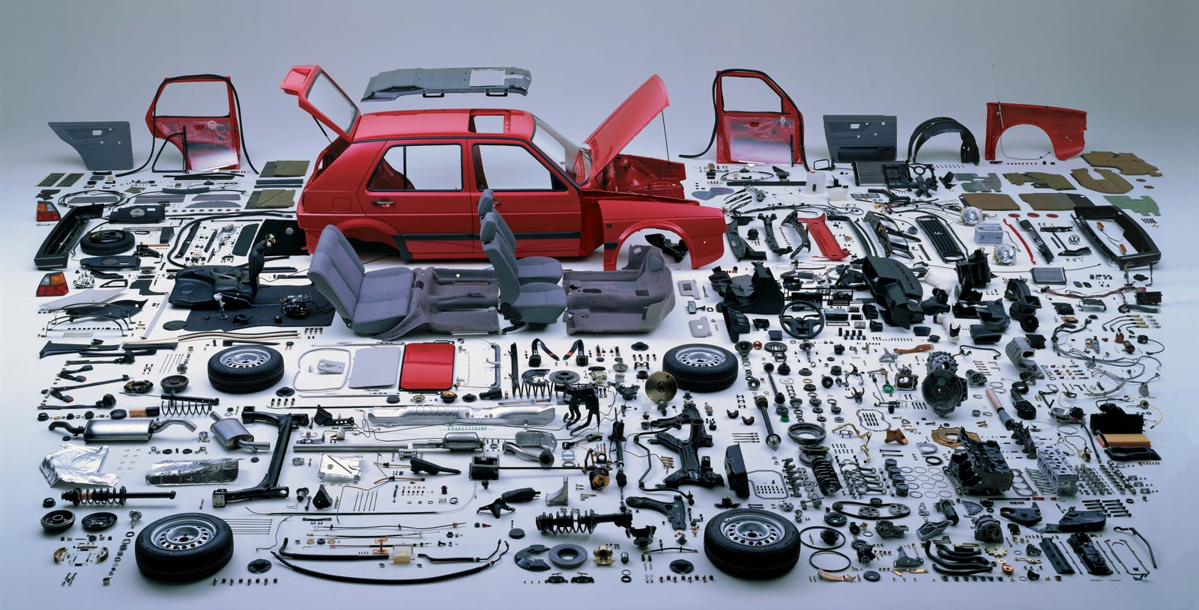
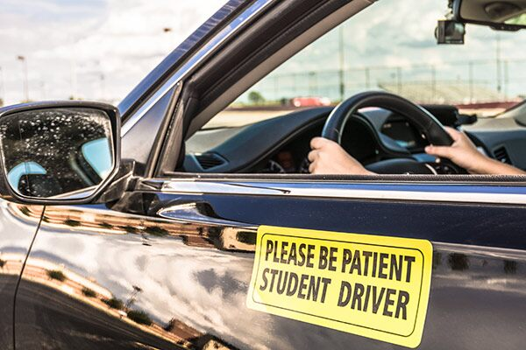
How To Learn Something
Options:
Books / Online Documentation
Online Courses like Udemy or Coursera / YouTube Videos
University / Executive Accelerated Certificate Courses
If learning how to drive was like learning Machine Learning…

Slide 4
What You Need / What You Get
Data:
Bring your own, Google Search, Kaggle competitions, etc.
Hardware:
Google Drive
Google Colab Notebook (or Jupyter Notebook)
Free GPU (12GB NVIDIA Tesla K80) and TPU
Some hyperparameter tuning may be needed (low memory)
Use “Move Mouse” for longer running tasks (stops timeouts)
Software:
Python 3 / PyTorch (*)
fast.ai Library and Video Series
Codification of modern ML best practices
(7) 2+ hour instructional videos (Part 1)
Exceptionally readable documentation and articles
Complete Colab/Jupyter notebooks with code and data

Slide 5
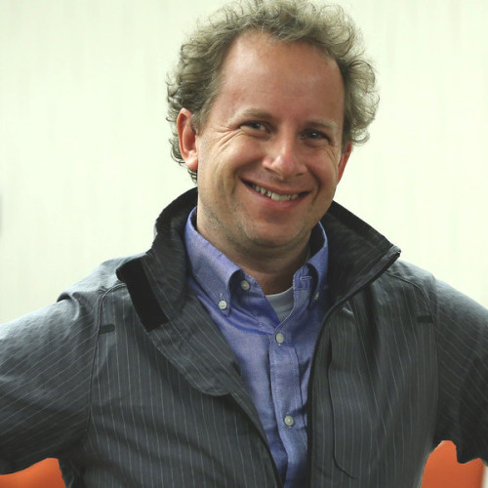
Meet the Instructor
Jeremy Howard
Founder and CEO of Enlitic (medical deep learning)
Faculty member at Singularity University
Past president of Kaggle (deep learning competitions)
Founded and exited from FastMail.FM and Optimal Decisions Group

Slide 6
Things You Do In 7 Lessons of Fast.ai
Can Do:
Computer Vision
Natural Language Processing (NLP)
Tabular Data
Collaborative Filtering
Will Do:
Predict supermarket sales
Auto classify movie sentiment from review text
Recommend movies
Auto classify pet photos
Improve the resolution of low res/damaged images
Bonus: Extend this into a black and white photo colorizer

Slide 7
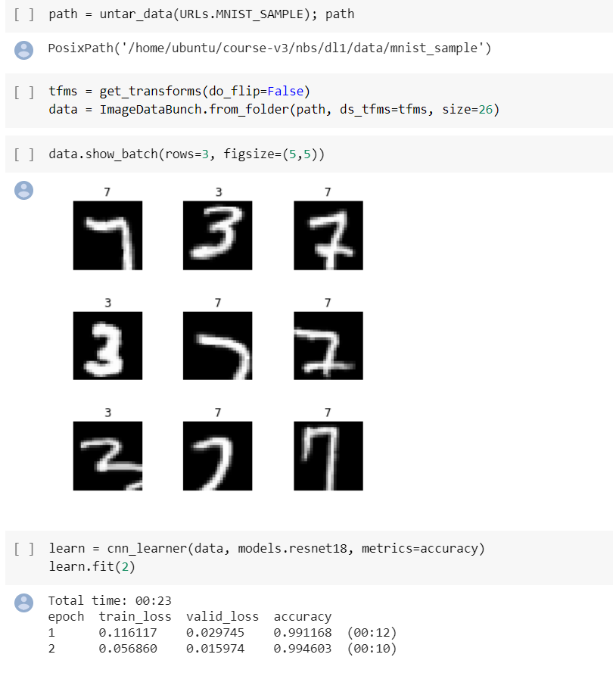
Example 1: MNIST (ML Hello World)
Modified National Institute of Standards and Technology

Slide 8
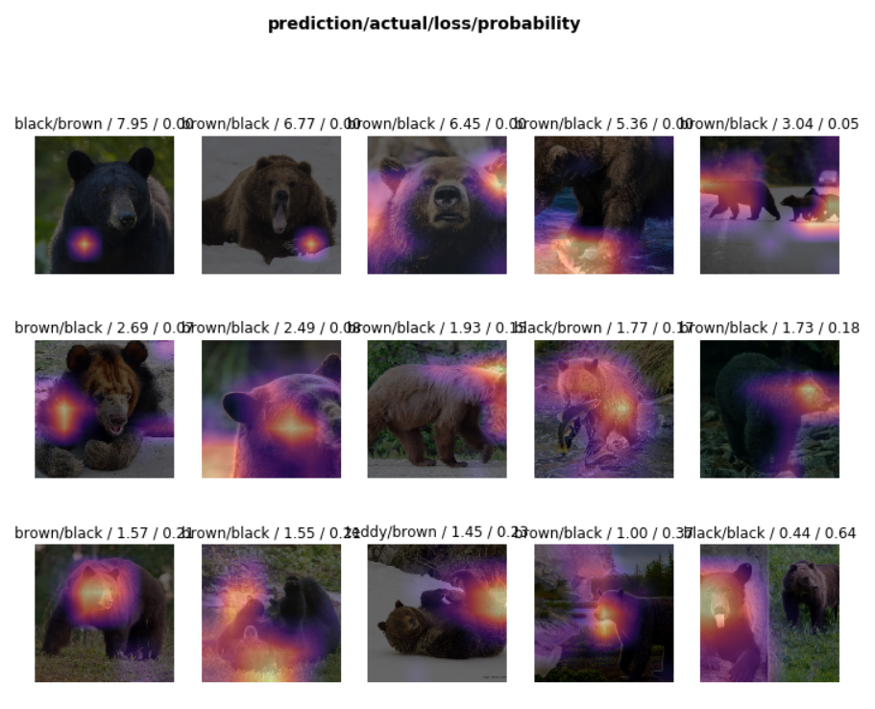
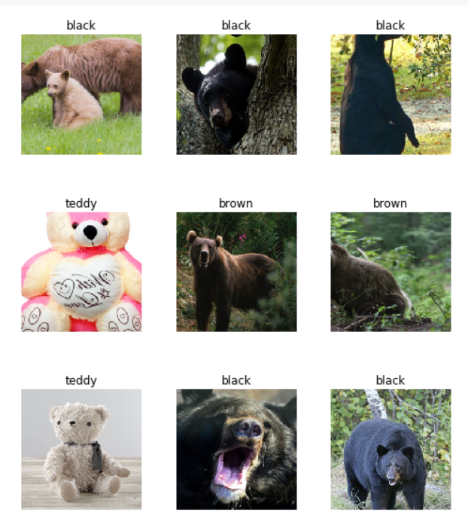
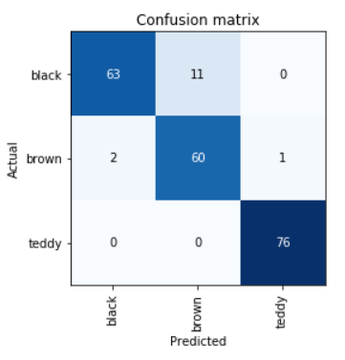
Example 2: Bear Classification

Slide 9
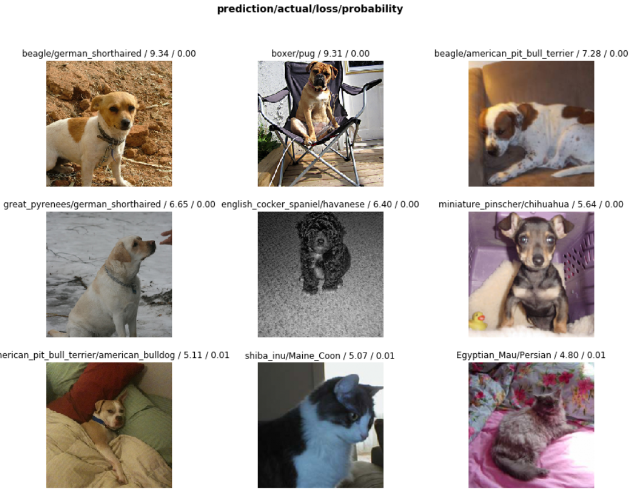
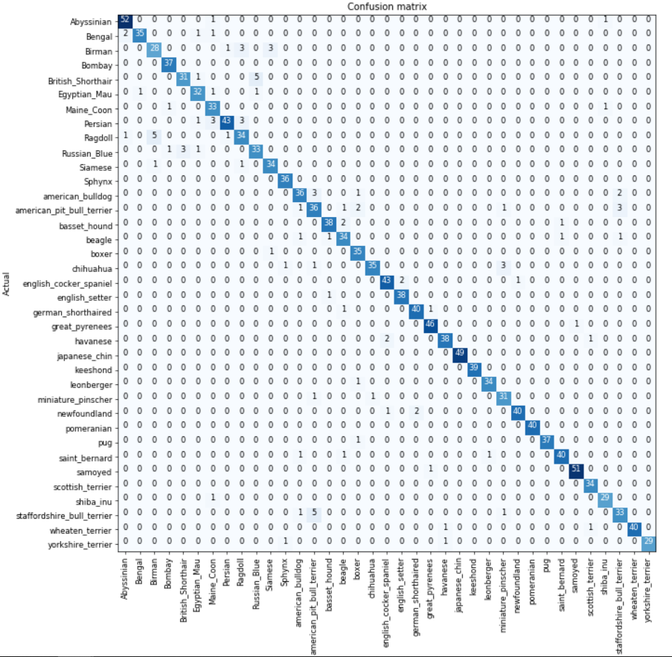
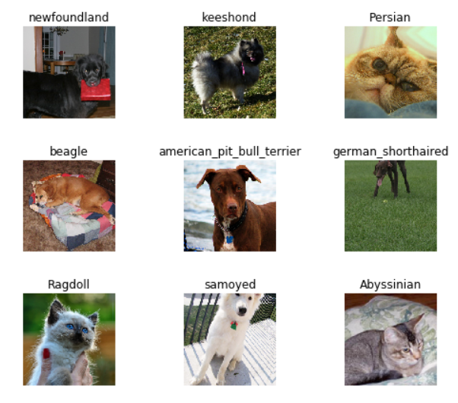
Example 3: Pet Classification
Oxford IIIT Pet: 37 category pet dataset with roughly 200 images for each class.

Slide 10
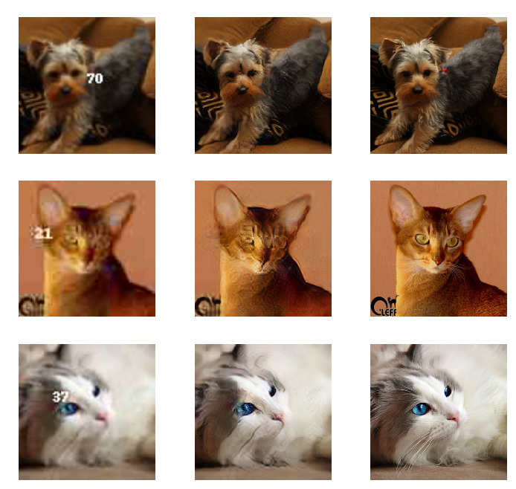
Example 4: Image Decrappifier

Slide 11
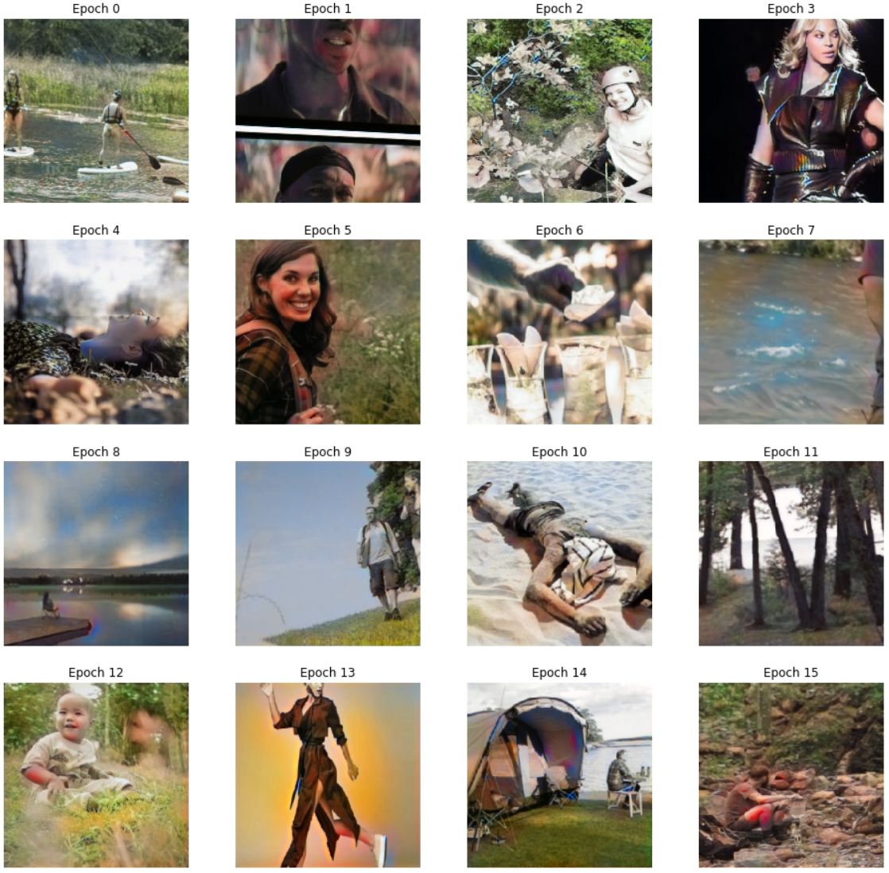
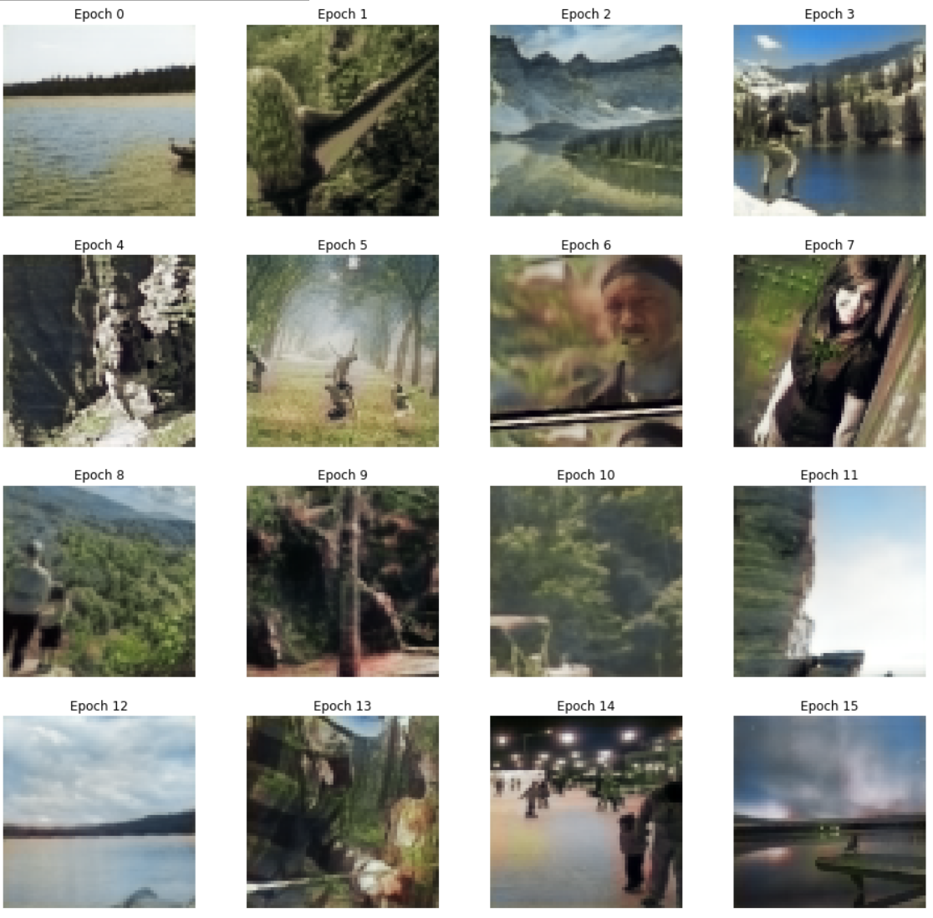
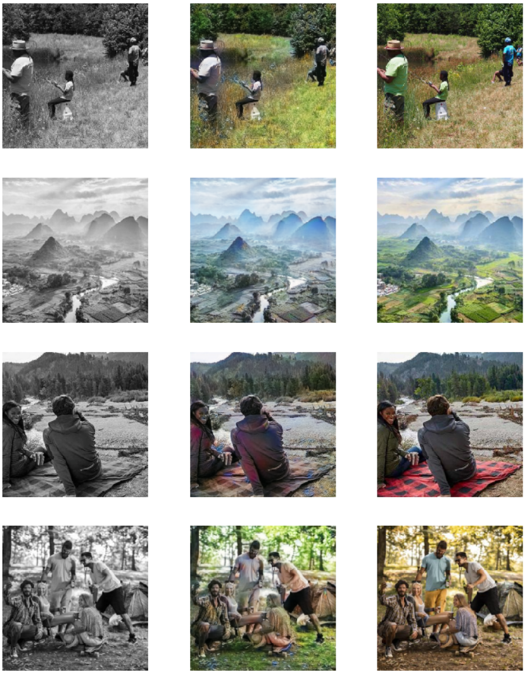
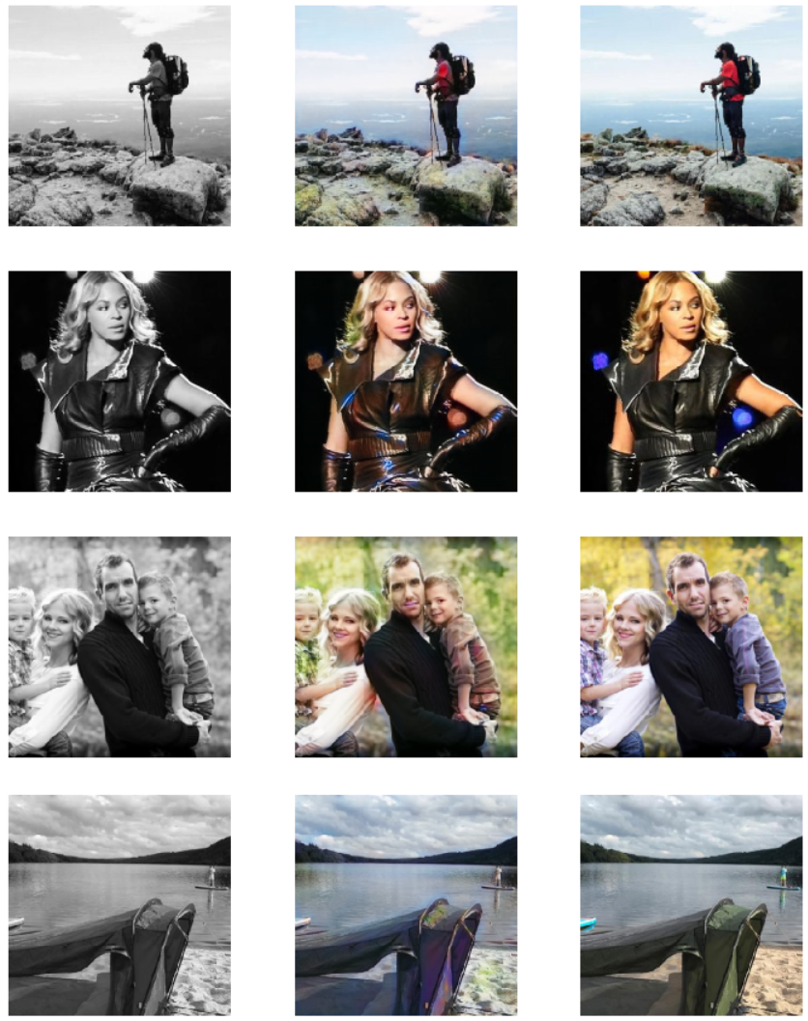
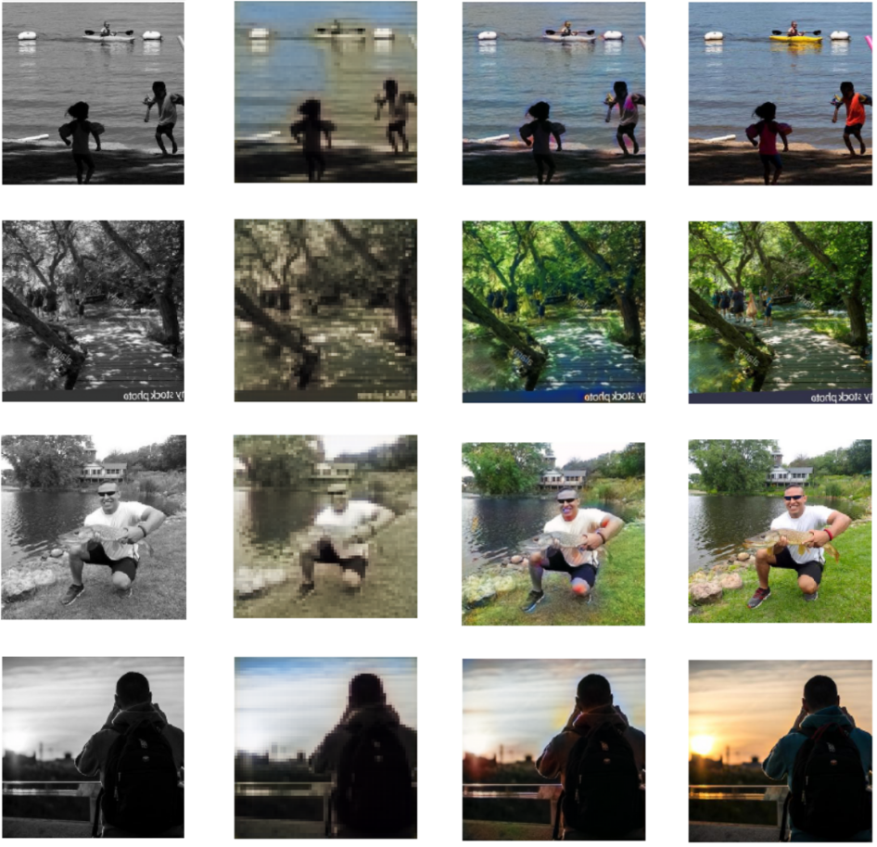
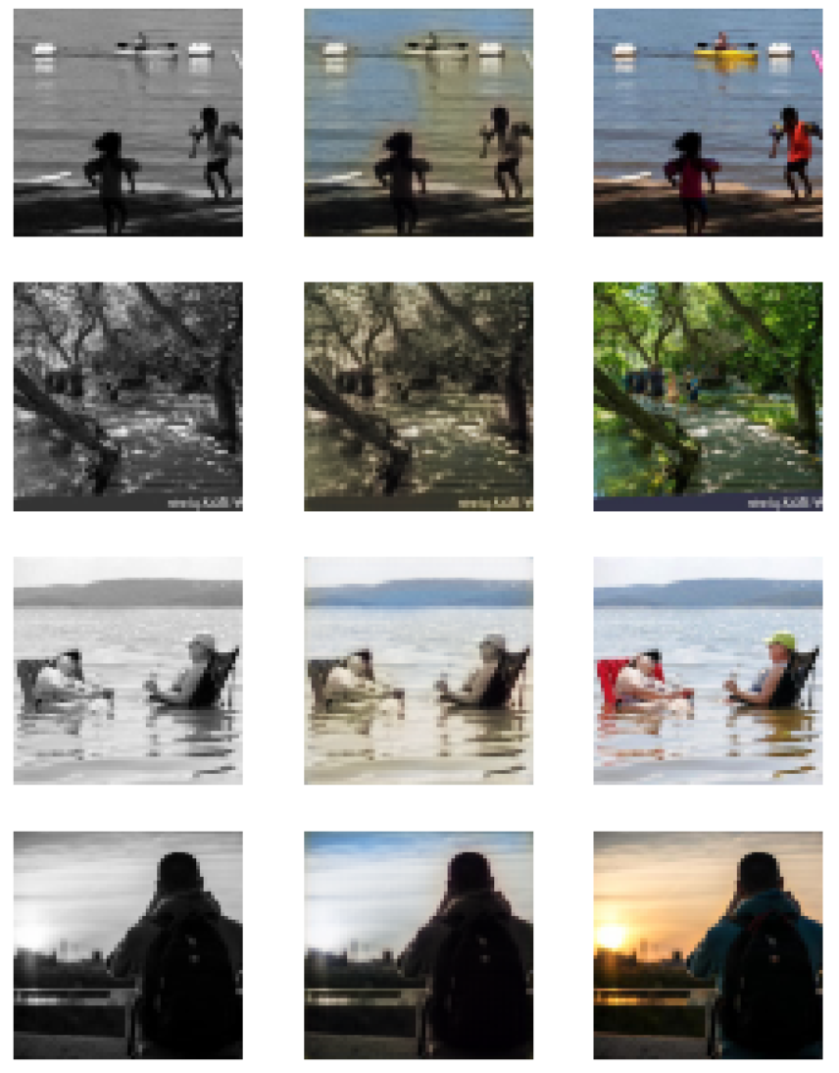
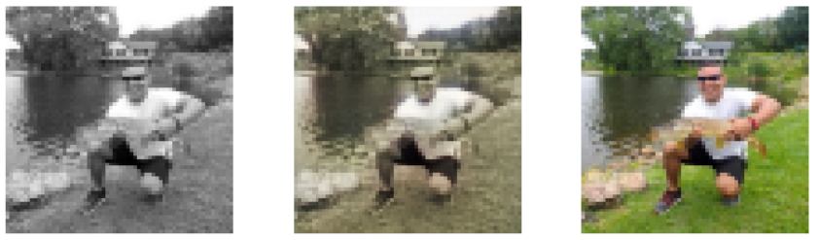
Example 4+: Image Colorizer
B/W Source
B/W Source
Final Generated
Final Colorized
Original Image
B/W Source
1st Colorized
Original Image
B/W Source
Final Colorized
Original Image
1st Generated
Original Image
Generative Adversarial Network (GAN)
Train with mostly outdoor images and people
631 images at 640x640 resolution (augmented to 2,516)
1st Round of Training
60 Epochs
~1 hour
2nd Round of Training
60 Epochs
~5.5 hours
Pre-train the “Generator”
(4 minutes)
Final Output
Comparison

Slide 12
Links and Information
Fastai Links:
Home: course.fast.ai
Video #1: course.fast.ai/videos/?lesson=1
Documents: docs.fast.ai
Github repo: github.com/fastai/course-v3
Deep Learning (Goodfellow, Bengio, Courville): bit.ly/2NaUN8x
Stanford Computer Vision (16 lecture videos ~1 hour each): bit.ly/2qbrpG8
Cleveland AI Meetup: meetup.com/Cleveland-Artificial-Intelligence-Group
Kaggle Competitions: kaggle.com/competitions
My “B/W to Color” Colab Notebook: https://github.com/jdw5155/BW2Color

